Slide 1
Econ 200 Module 5 Lecture 13

Slide 2
Outline
The firm’s shut down decision
Deriving firm and market supply
Long run responses to profit and loss
Efficiency
Reading: Ch 13.4-13.8, second half

Slide 3
Identifying Whether a Firm Can Make a Profit
Once we have determined the quantity where MC=MR, we can immediately know whether the firm is making a profit, breaking even, or making a loss. At that quantity,
If P > ATC, the firm is making a profit
If P = ATC, the firm is breaking even
If P < ATC, the firm is making a loss

Slide 4
Short Run Responses of Perfectly Competitive Firms to Losses
Suppose a firm in a perfectly competitive market is making a loss. It has two options:
Continue to produce, or
Stop production by shutting down temporarily
If the firm shuts down, it will still need to pay its fixed costs.
The firm’s fixed costs should be treated as sunk costs in the short run, but sunk costs should be irrelevant to the firm’s decision-making.

Slide 5
The Firm’s Shut Down Decision in the Short Run
Another way of writing firm profits in the short run:
Profit = (P-ATC)*q = (P-AVC-AFC)*q
Profit = (P-AVC)*q – FC (because FC paid regardless of q)
Then, examine two cases:
1. P>AVC → Profit > -FC
2. P<AVC → if q>0, then Profit < -FC
if q=0, then Profit = -FC
→Firm better off not producing anything!
Notes:
Important note to Professors: For the 2nd printing of this textbook in June 2014, the authors changed the numbers in Table 12.4 to address a consistency issue. Please refer to book page 407 where Table 12.4 appears.
If you are using the 1st printing, this slide will match the book.
If you are using the 2nd printing, this slide will not match the book, so skip this slide and use slide 32 instead.

Slide 6
The Supply Curve of a Firm in the Short Run
The firm’s shut down decision is based on its variable costs; it should produce nothing only if:
P < AVC
Or… Multiplying by Q:
(P x Q) < AVC x Q
Total Revenue < Variable Cost

Slide 7
The Supply Curve of a Firm in the Short Run
Therefore, the firm’s output decision at every price can be given by:
Q(P) =
0 if P < AVC
The quantity Q where P=MC(Q)
→The marginal cost curve (above the min AVC curve – why?) gives us the relationship between price and quantity supplied: it is the firm’s supply curve!

Slide 8
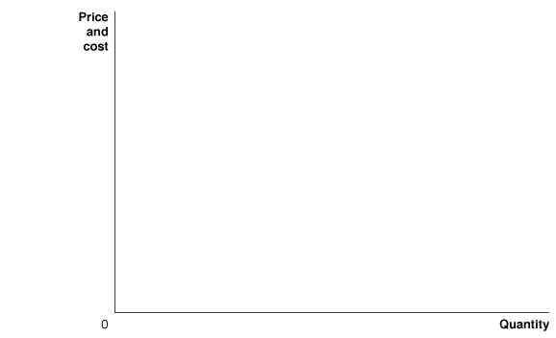


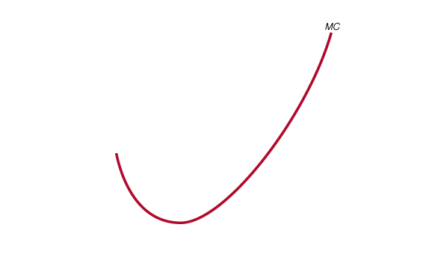
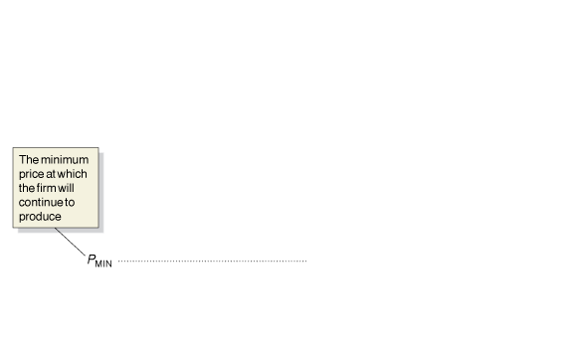
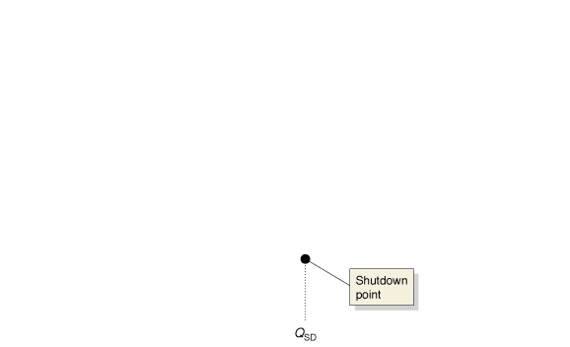



The Firm’s Short-Run Supply Curve
The firm will produce at the level of output at which MR = MC.
Because P=MR in a PC market, the firm will produce where P = MC.
And the quantity supplied is zero below the point where
P< min AVC
Notes:
Because price equals marginal revenue for
a firm in a perfectly competitive market,
the firm will produce where P = MC. For
any given price, we can determine the quantity
of output the firm will supply from the
marginal cost curve, so the marginal cost
curve is the firm’s supply curve. But the firm
will shut down if the price falls below average
variable cost. The marginal cost curve
crosses the average variable cost at the firm’s
shutdown point at the output level QSD. For
prices below PMIN, the supply curve is a vertical
line along the price axis, which shows
that the firm will supply zero output at those
prices. The red line is the firm’s short-run
supply curve.

Slide 9
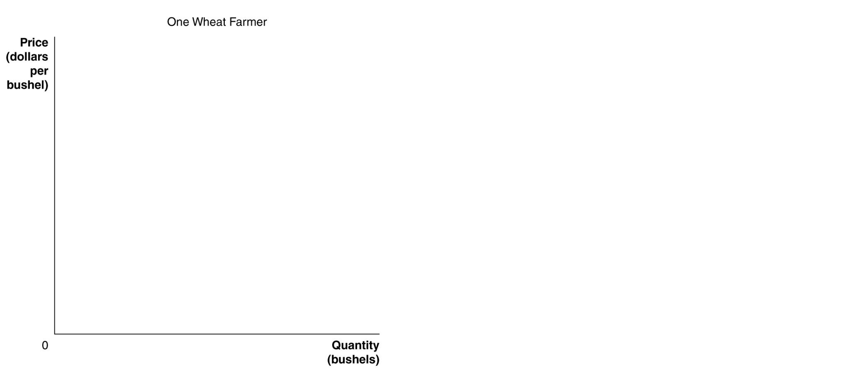

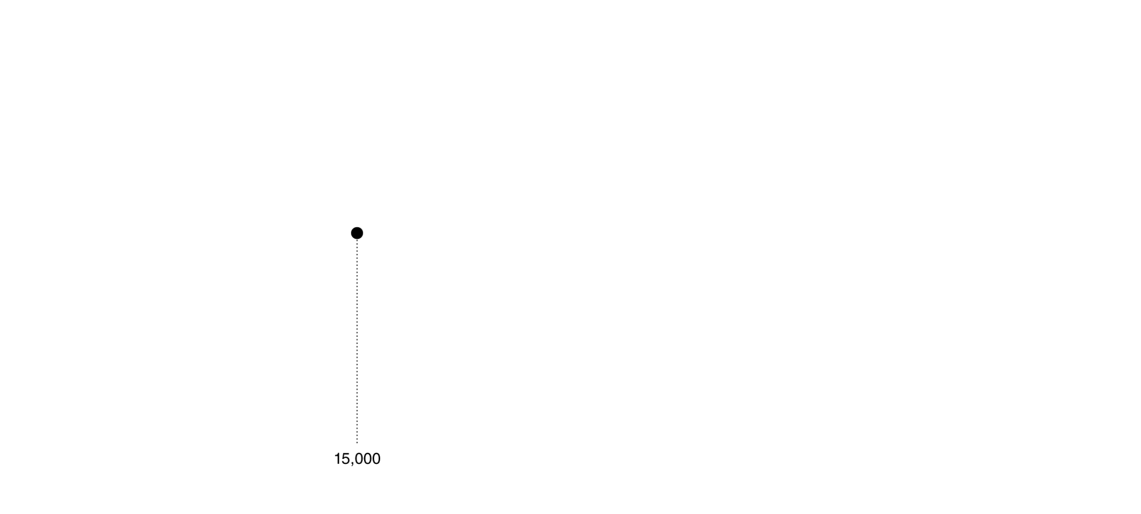

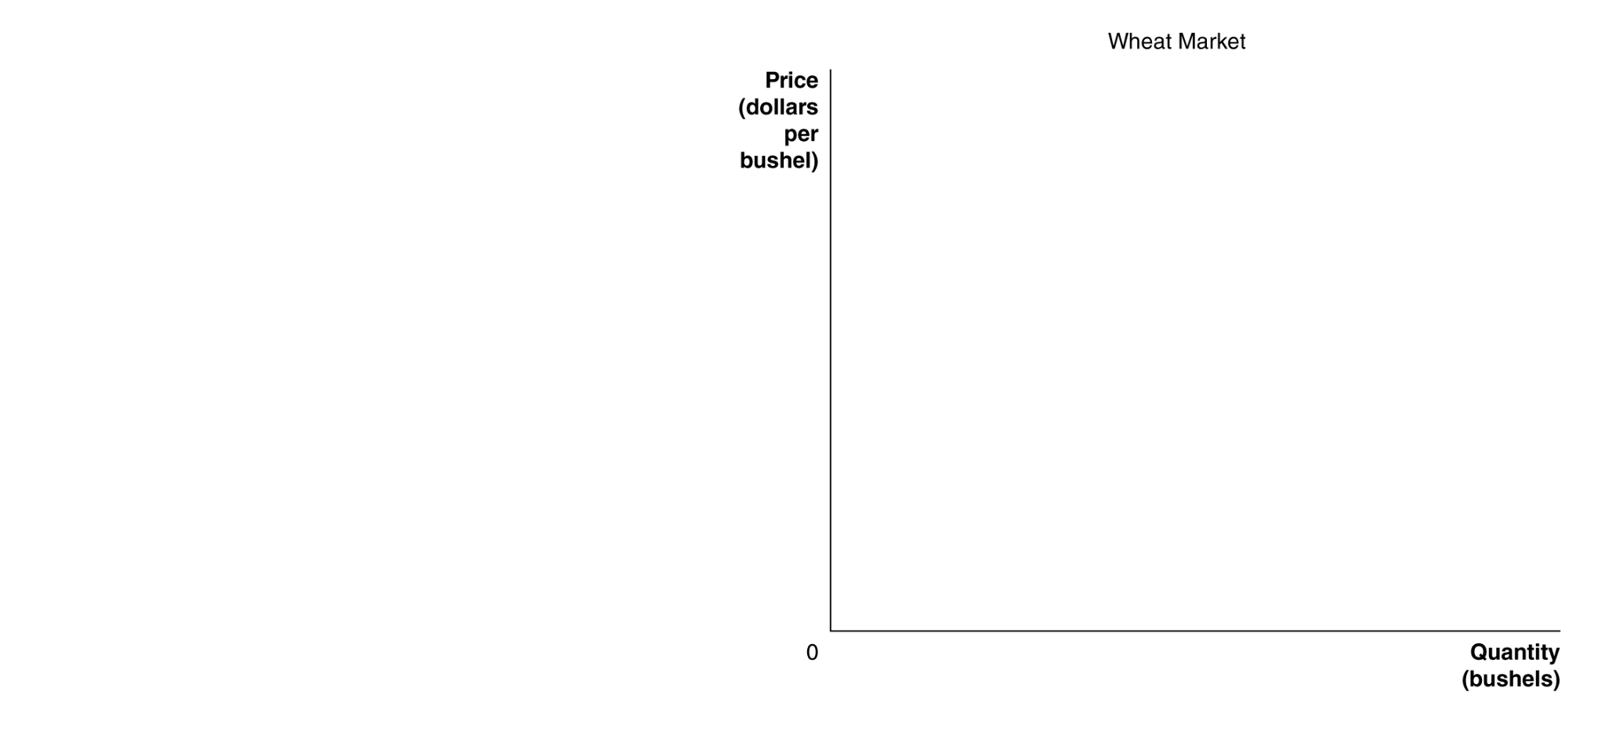

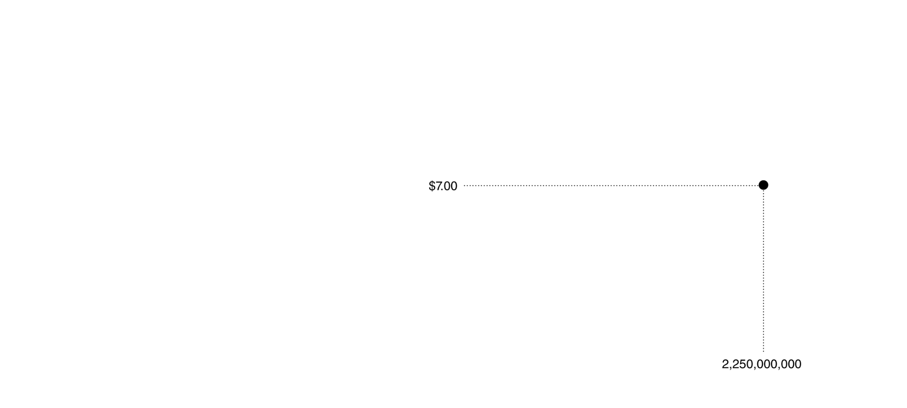

Short-Run Market Supply Curve
Firm supply and market supply
Individual wheat farmers take the price as given…
…and choose their output according to the price.
The collective actions of the individual farmers determine the market supply curve for wheat.
Notes:
We can derive the market supply curve by adding up the quantity that each firm
in the market is willing to supply at each price. In panel (a), one wheat farmer is
willing to supply 15,000 bushels of wheat at a price of $7 per bushel. If every wheat
farmer supplies the same amount of wheat at this price and if there are 150,000
wheat farmers, the total amount of wheat supplied at a price of $7 will equal
15,000 bushels per farmer * 150,000 farmers = 2.25 billion bushels of wheat.
This amount is one point on the market supply curve for wheat shown in panel
(b). We can find the other points on the market supply curve by determining how
much wheat each farmer is willing to supply at each price.

Slide 10
Will Firms Stay Shut Down Forever?
In the long run, firms making profit < 0 (whether or not they are “shut down”) can leave the market permanently.
Remember: In the long run, all inputs are variable, so the firm can get rid of its capital and move on to a market with more demand.
On the other hand, if existing firms are making profit > 0, new firms will decide to enter the market.
(Perfect Competition assumes that there is free entry and exit into the market in the long run)

Slide 11
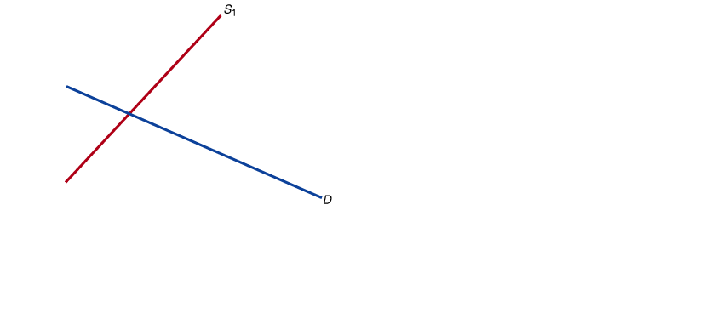

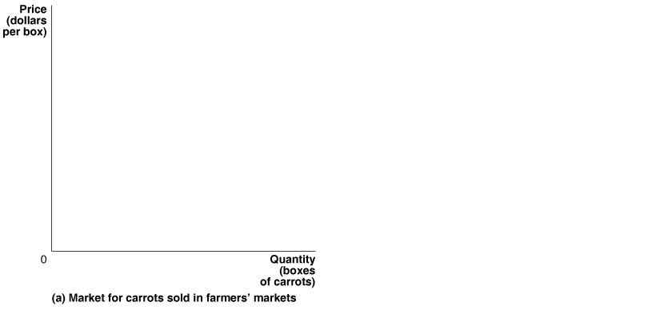
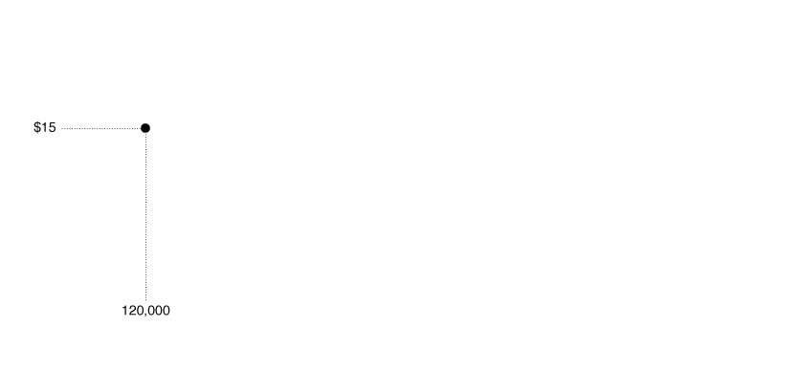
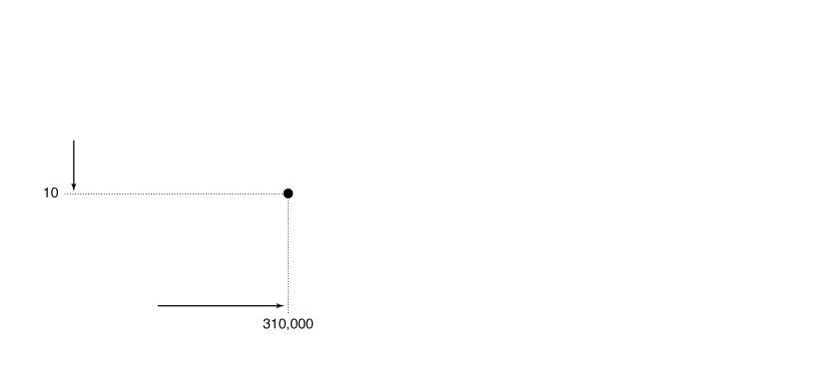

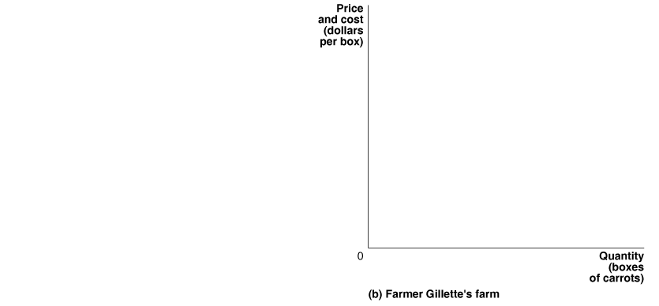
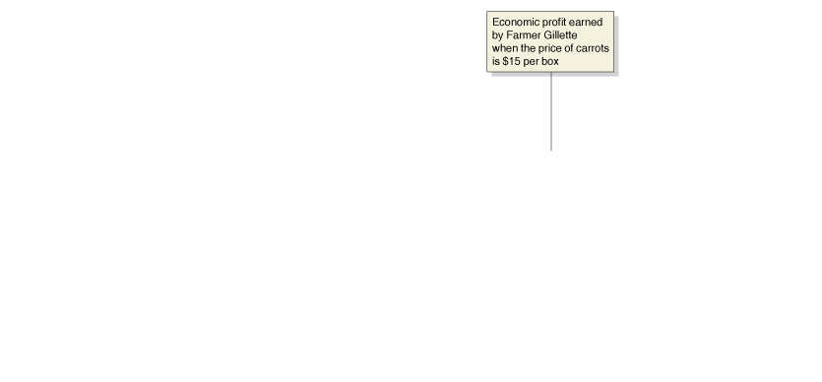
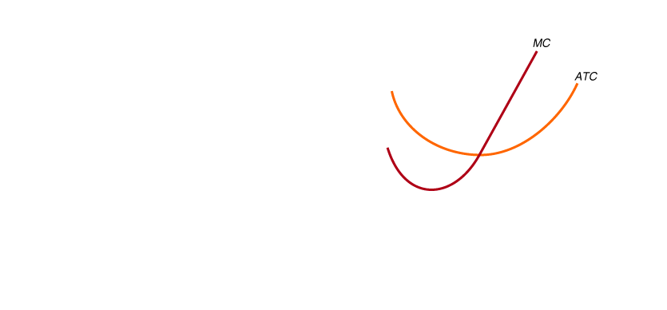
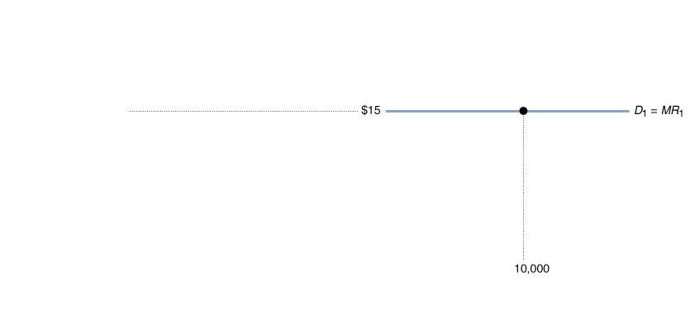
The Effect of Entry on Economic Profit
The farmer makes an economic profit when the price is $15.
The profit attracts new firms, which increases supply → Mkt price falls.
Notes:
Initially, Farmer Gillette and other farmers selling carrots in farmers’ markets are
able to charge $15 per box and earn an economic profit. Farmer Gillette’s economic
profit is represented by the area of the green box in panel (b). Panel (a) shows
that as other farmers begin to sell carrots in farmers’ markets, the market supply
curve shifts to the right, from S1 to S2, and the market price drops to $10 per box.
Panel (b) shows that the falling price causes Farmer Gillette’s demand curve to shift
down from D1 to D2, and she reduces her output from 10,000 boxes to 8,000. At the
new market price of $10 per box, carrot growers are just breaking even: Their total
revenue is equal to their total cost, and their economic profit is zero. Notice the difference
in scale between the graphs in panels (a) and (b).

Slide 12

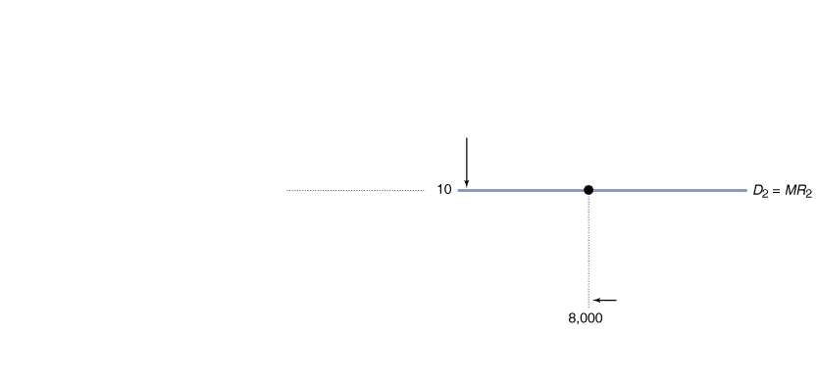
The Effect of Entry on Economic Profit—continued
P falls until there is no incentive for further firms to enter the market (profit = 0).
For this to be true, the price must be equal to ATC; but since P=MC, that means all three must be equal.

Slide 13
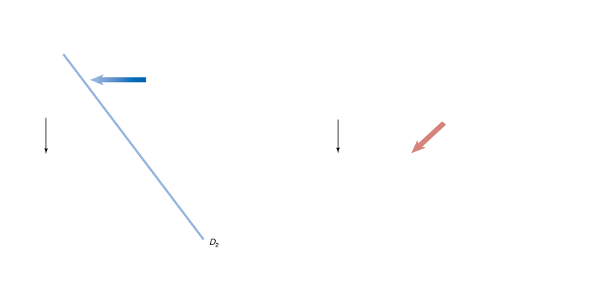

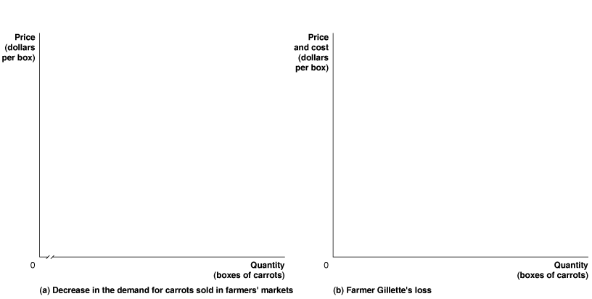


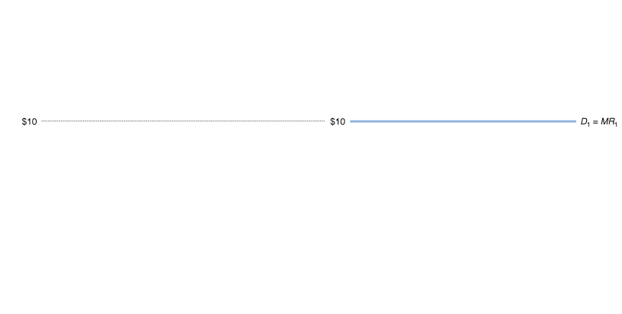

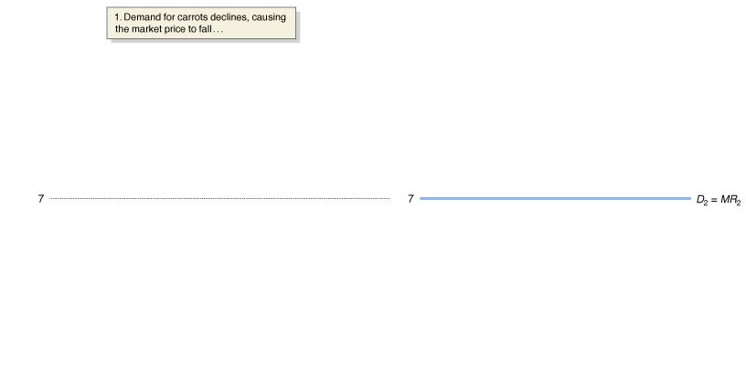

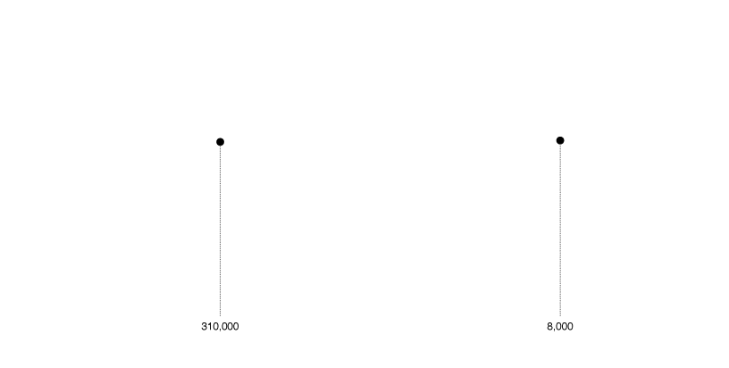
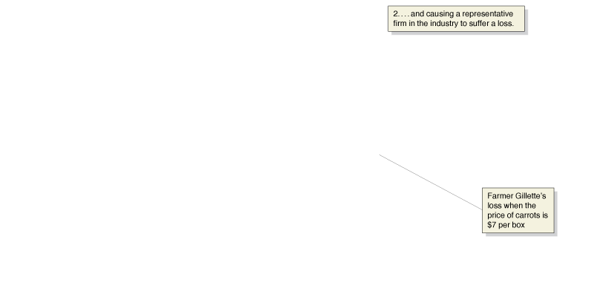
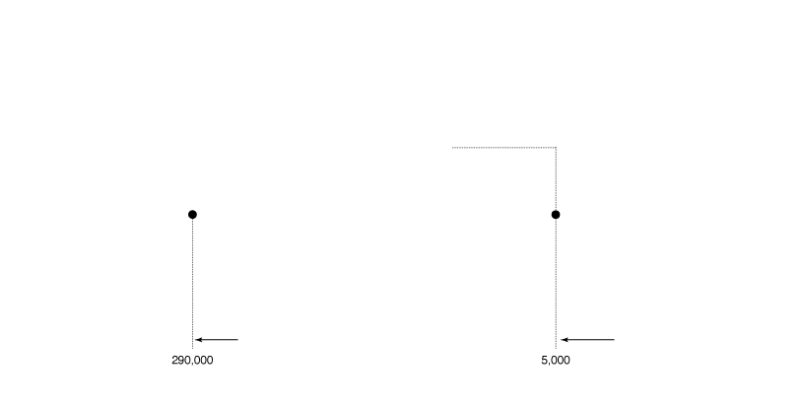
The Effect of Economic Losses
Now price is $10 per box, and carrot farmers are breaking even.
Then demand for carrots falls. Price falls to $7 per box.
Sacha can no longer make a profit; she makes the smallest loss possible by producing 5000 carrots: where MC = MR.
Notes:
When the price of carrots is $10 per box, Farmer Gillette and other farmers are breaking
even. A total quantity of 310,000 boxes is sold in the market. Farmer Gillette sells
8,000 boxes. Panel (a) shows a decline in the demand for carrots sold in farmers’
markets from D1 to D2 that reduces the market price to $7 per box. Panel (b) shows
that the falling price causes Farmer Gillette’s demand curve to shift down from D1 to
D2 and her output to fall from 8,000 to 5,000 boxes. At a market price of $7 per box,
farmers have economic losses, represented by the area of the red box. As a result, some
farmers will exit the market, which shifts the market supply curve to the left. Panel (c)
shows that exit continues until the supply curve has shifted from S1 to S2 and the market
price has risen from $7 back to $10. Panel (d) shows that with the price back at $10,
Farmer Gillette will break even. In the new market equilibrium in panel (c), total sales
of carrots in farmers’ markets have fallen from 310,000 to 270,000 boxes.

Slide 14
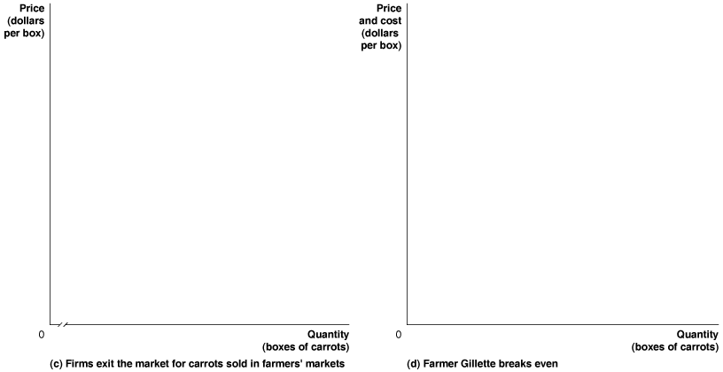


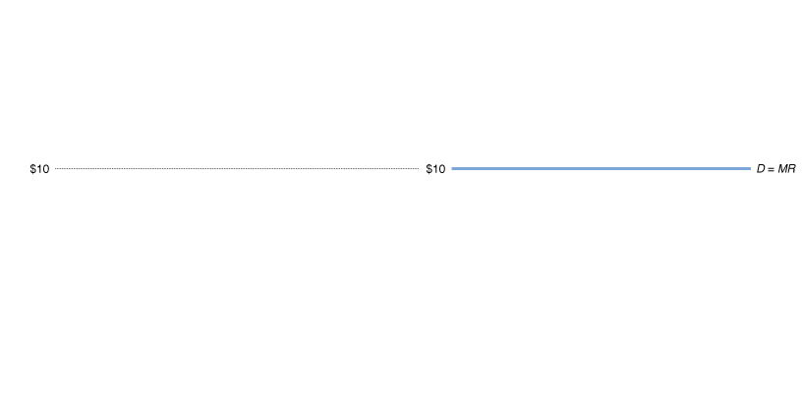
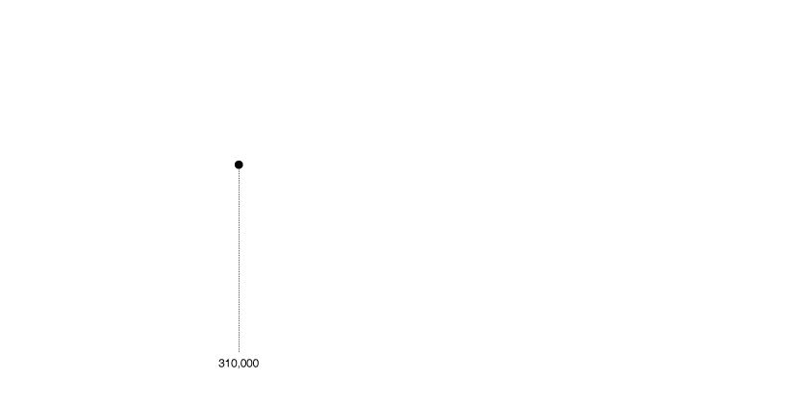
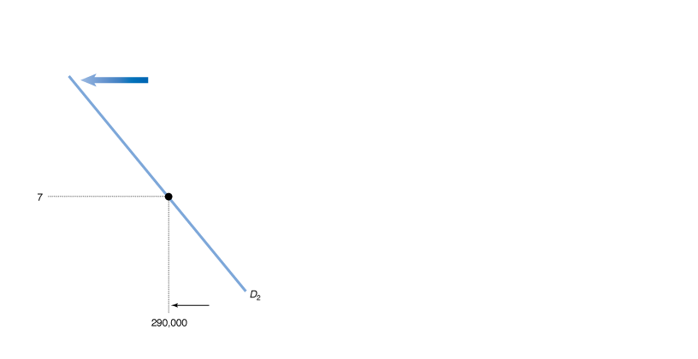


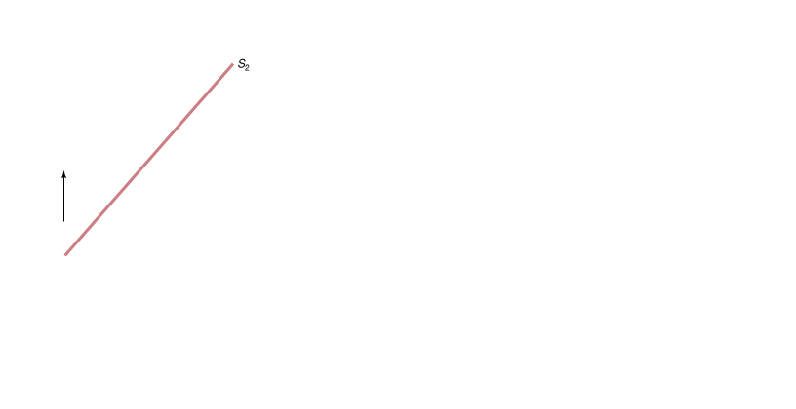
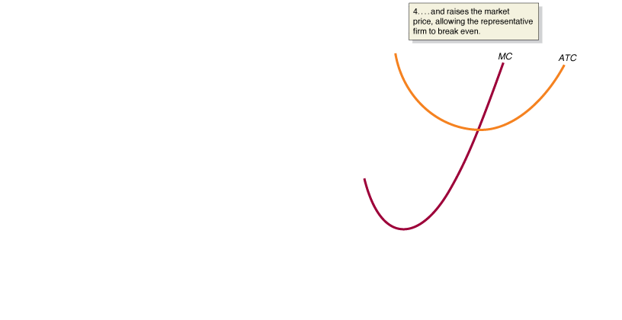
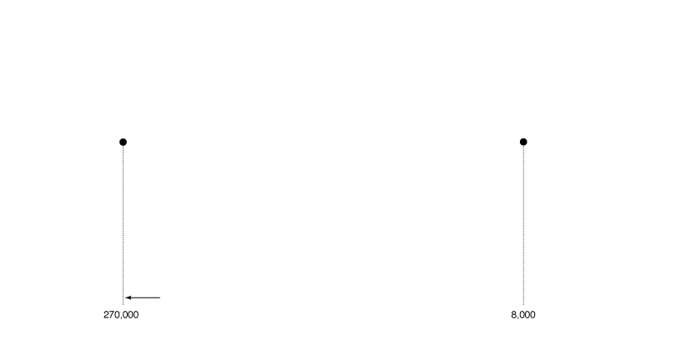
The Effect of Economic Losses—continued
Discouraged by the losses, some firms will exit the market.
The resulting decrease in supply causes prices to rise.
Firms continue to leave until price returns to the break-even price of $10 per box.

Slide 15
Long-Run Equilibrium in a Perfectly Competitive Market
If profit>0:
→additional firms enter the market, price falls to the break- even level.
If profit<0:
→Existing firms exit the market, price rises to the break even level.
Long-run competitive equilibrium: The situation in which the entry and exit of firms has resulted in the typical firm breaking even (receiving zero economic profit).

Slide 16
Long-Run Supply in a Perfectly Competitive Market
This means that in the long run, the market will supply any demand by consumers at a price equal to the minimum point on the typical firm’s average cost curve.
Hence, in many industries, the long-run supply curve is horizontal at P= min ATC.

Slide 17

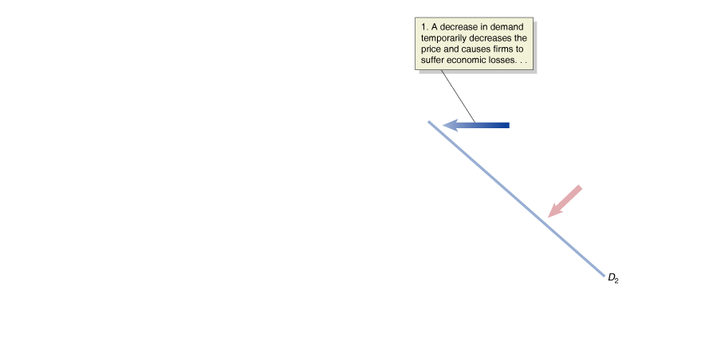

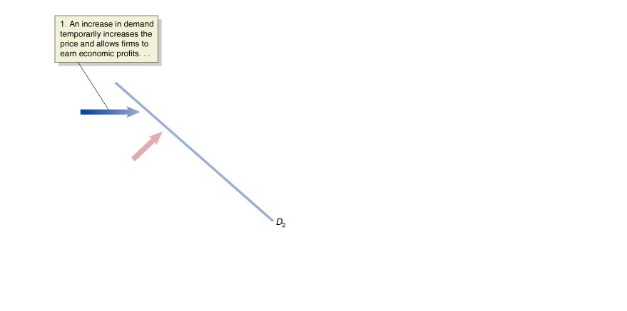
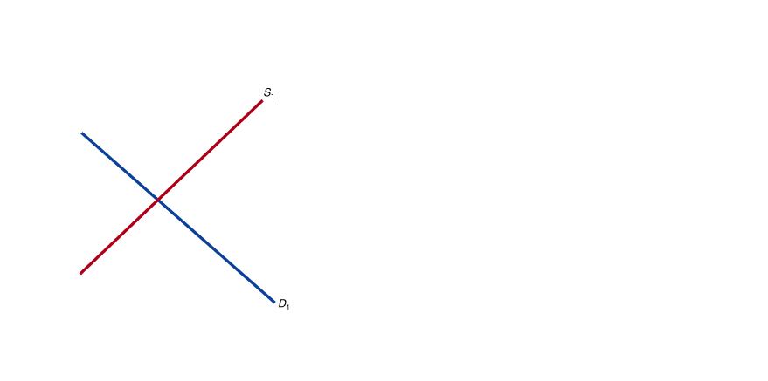
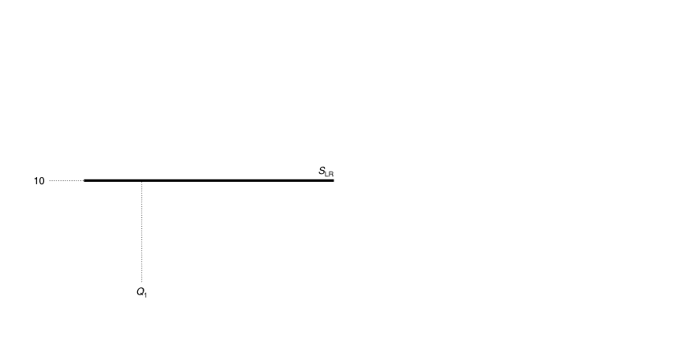

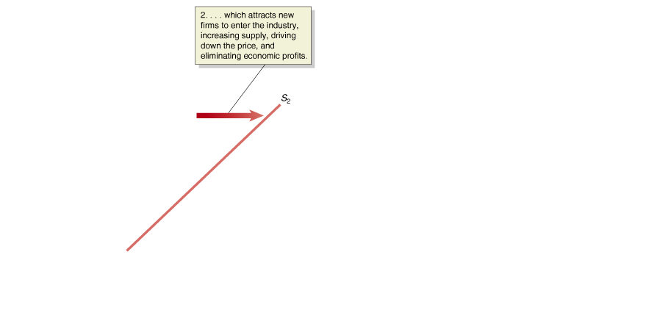
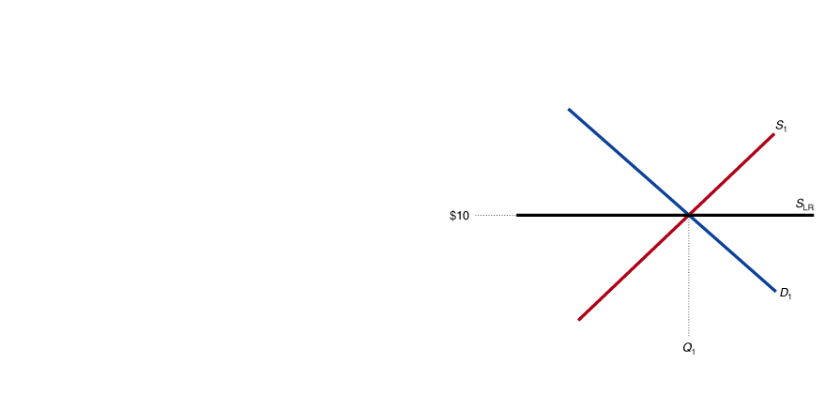

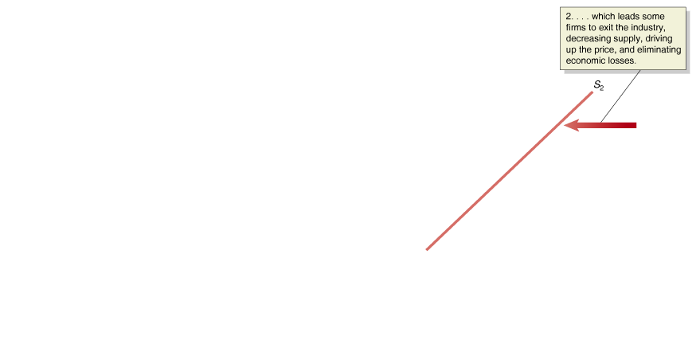
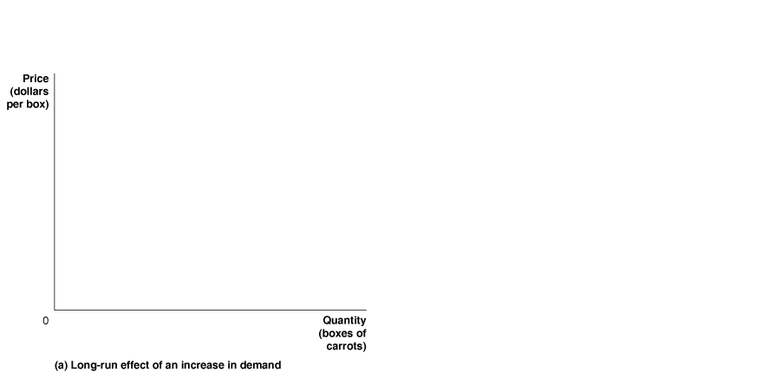
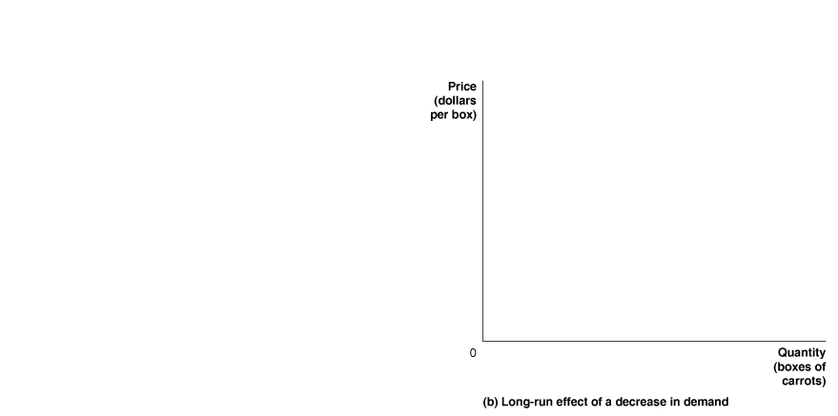
Long-Run Supply
The panels show how price always returns to the long-run (break-even) level.
Notes:
Panel (a) shows that an increase in demand for carrots sold in farmers’ markets
will lead to a temporary increase in price from $10 to $15 per box, as the market
demand curve shifts to the right, from D1 to D2. The entry of new firms shifts
the market supply curve to the right, from S1 to S2, which will cause the price to
fall back to its long-run level of $10. Panel (b) shows that a decrease in demand
will lead to a temporary decrease in price from $10 to $7 per box, as the market
demand curve shifts to the left, from D1 to D2. The exit of firms shifts the market
supply curve to the left, from S1 to S2, which causes the price to rise back to
its long-run level of $10. The long-run supply curve (SLR) shows the relationship
between market price and the quantity supplied in the long run. In this case, the
long-run supply curve is a horizontal line.

Slide 18
Increasing-Cost and Diminishing-Cost Industries
Examples of non-horizontal long run supply curves:
If some factor of production cannot be replicated, additional firms may have higher costs of production.
On the other hand, sometimes additional firms might generate benefits for other firms in the market, leading additional firms to have lower costs of production.

Slide 19
Types of Efficiency
Efficiency in economics really refers to two separate but related concepts:
Productive efficiency is a situation in which a good or service is produced at the lowest possible cost.
Allocative efficiency is a state of the economy in which production represents consumer preferences; in particular, every good or service is produced up to the point where the last unit provides a marginal benefit to consumers equal to the marginal cost of producing it.

Slide 20
Are Perfectly Competitive Markets Efficient?
We have shown that in the long run, perfectly competitive markets are productively efficient.
But they are allocatively efficient also:
P=Marginal Benefit of last unit sold
P=Marginal Cost of last unit sold in PC markets
Therefore, firms produce up to the point where MB=MC for last unit produced.
Productive and allocative efficiency are useful benchmarks against which to measure the actual performance of other markets.

Slide 21
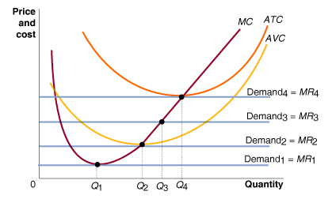
Refer to the figure below. Which demand curve would result in the firm shutting down?
Demand₁
Demand₂
Demand₃
Demand₄

Slide 22
Refer to the figure below. Which demand curve would result in the firm shutting down?
Demand₁

Slide 23
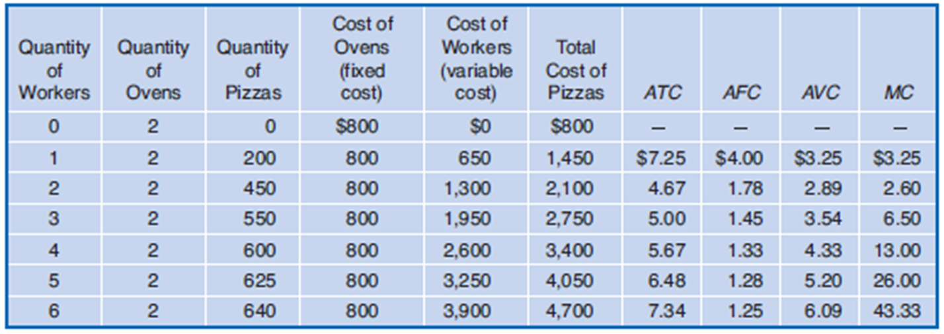
According to the table below, what is the firm’s shut down price?

Slide 24
Refer to the figure below. What is the firm’s shut down price?
Ps = min ATC = $2.89

Slide 25
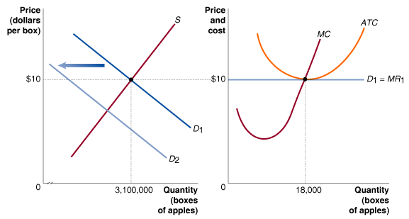
After the shift in market demand, how will the firm react?
The firm will adjust its output upward in search of higher profit.
The firm will have to adjust its output downward and suffer losses.
The firm will maintain output constant but suffer losses.
The firm will adjust its output downward and earn higher profit.

Slide 26
After the shift in market demand, how will the firm react?
b. The firm will have to adjust its output downward and suffer losses.

Slide 27
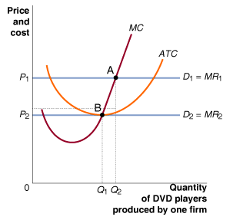
The graph below describes a typical firm in the competitive DVD player industry. Which point represents the combination of price and output levels that prevail when the DVD industry experiences productive efficiency?
Point A.
Point B.
Both points reflect productive efficiency.
Neither point reflects productive efficiency.

Slide 28
The graph below describes a typical firm in the competitive DVD player industry. Which point represents the combination of price and output levels that prevail when the DVD industry experiences productive efficiency?
b. Point B.

